Slide 1
STEP 2 – KNOW YOUR USER
Our apps sit rep…

Slide 2
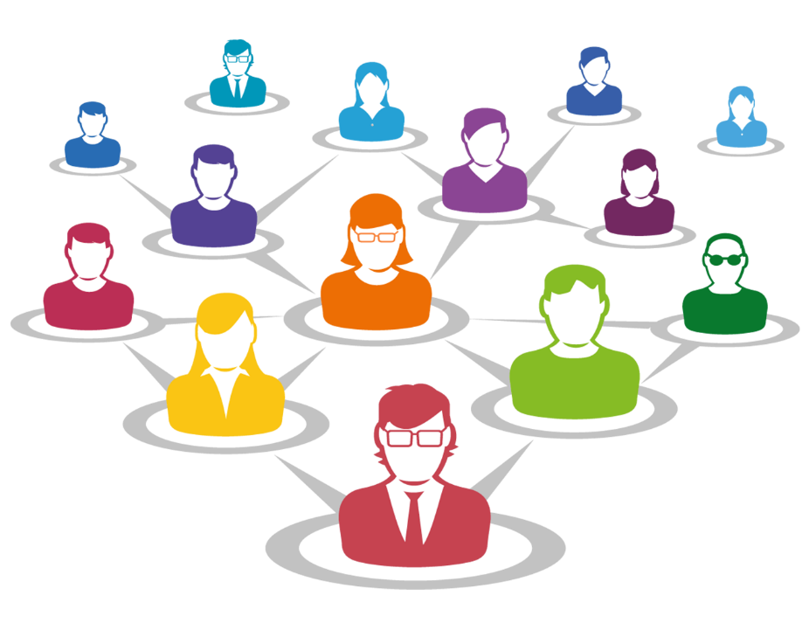
Step 2 Know Your User
The more you know about your user, the more you know about your app
Users groups for Facebook:
Keep in touch
Online photo album
Promotion
Viral messages
All of these groups will use Facebook differently

Slide 3
Step 2 Know Your User
There are certain features everyone needs from Facebook
Accessible
Easy to navigate
Security and Privacy
Notifications
Etc.
These combined give us the app’s requirements
To find out what your user requires you need to ask

Slide 4
CHALLENGE TIME!
Think about your mission (or our mission if you’re following my example) and come up with at least two user groups that might get some benefit from your app.
For bonus points (if possible) talk to someone from your user groups and ask what they might require from your finished application.
Share what you’ve discovered on our Slack Community!

Slide 5
Step 2 Know Your User
The users for our tracking app fall into two groups:
Drivers
Customers
Both groups need:
Easy-to-use
Secure
Accessible
These are our booking application’s requirements

